Slide 1
NAP4
Emergency Surgical Airway
Success & Failure
Chris Frerk & Tim Cook

Slide 2
Emergency Surgical Airway
80 people presenting for surgery, being cared for in ITU or coming to the ED ended up with an unplanned hole in the neck in an attempt to rescue a lost airway

Slide 3
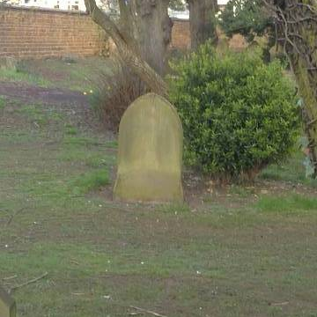
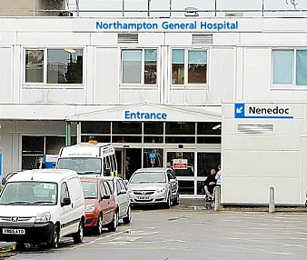
13 of them died
At least 7 ended up with ongoing disability

Slide 4
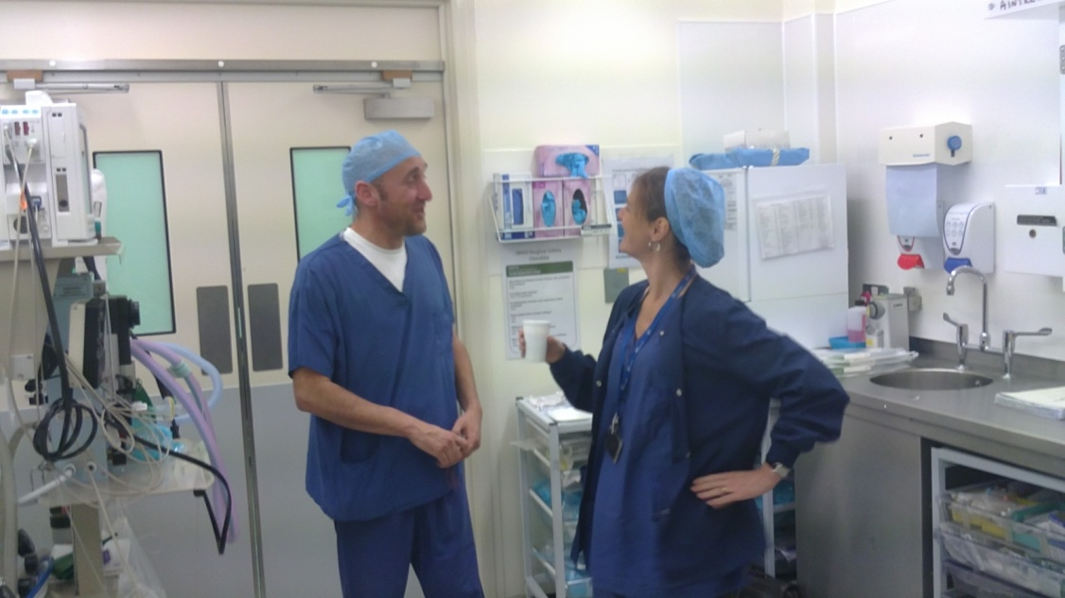
It will happen in your hospital.
You may be called urgently to help in the anaesthetic room next door!

Slide 5
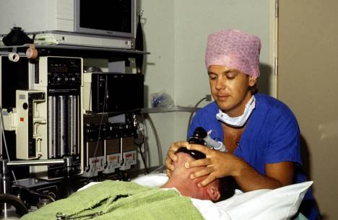
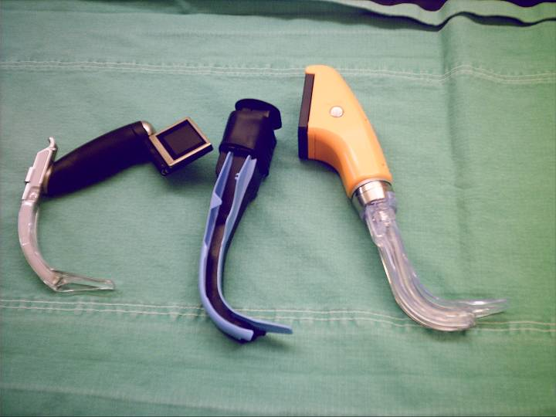
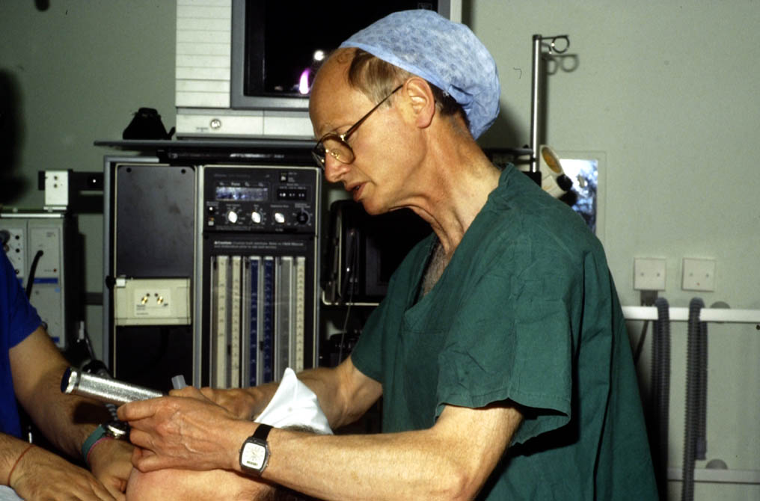
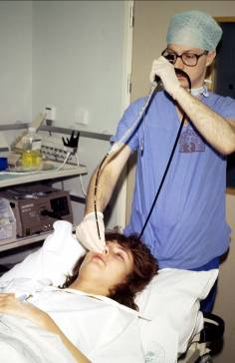
There is no one guaranteed “safe technique”

Slide 6
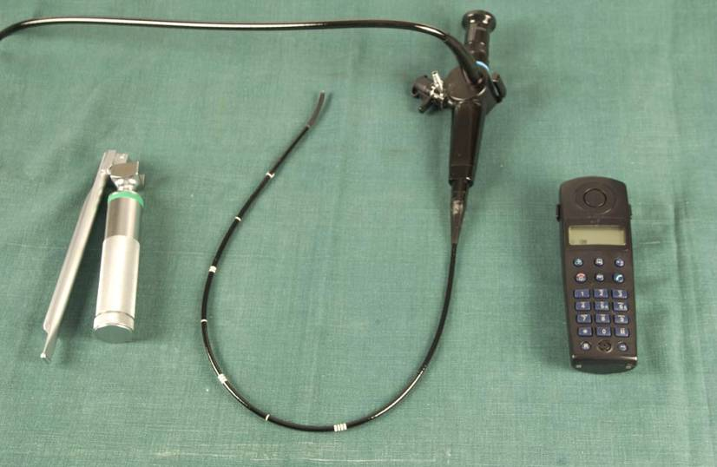
Awake techniques were not used when they should have been

Slide 7
If awake techniques are not in your skillset then seek assistance when presented with difficult cases

Slide 8
Even the best plan A may fail – always have clear fallback plans
Plan B
Plan C
Plan A
Plan D
Plan X

Slide 9
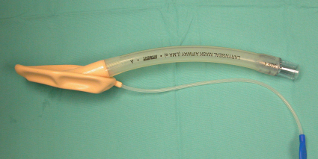
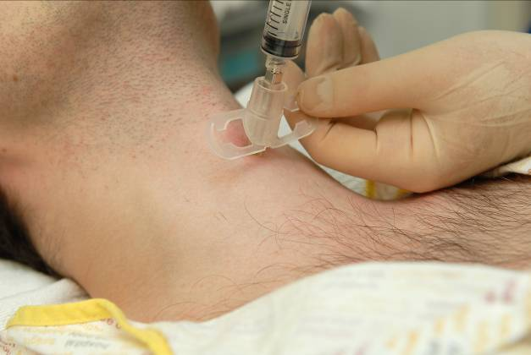
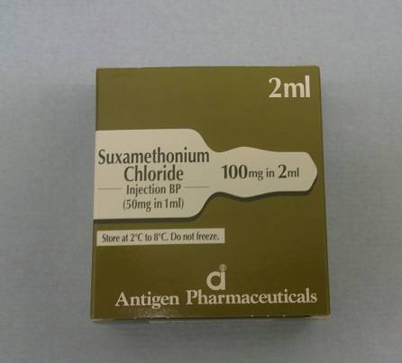
On many occasions LMAs & muscle relaxants were not used to attempt rescue prior to cricothyroidotomy

Slide 10
They should be

Slide 11
Emergency Surgical Airway
When all else fails
Emergency cric doesn’t always succeed!

Slide 12
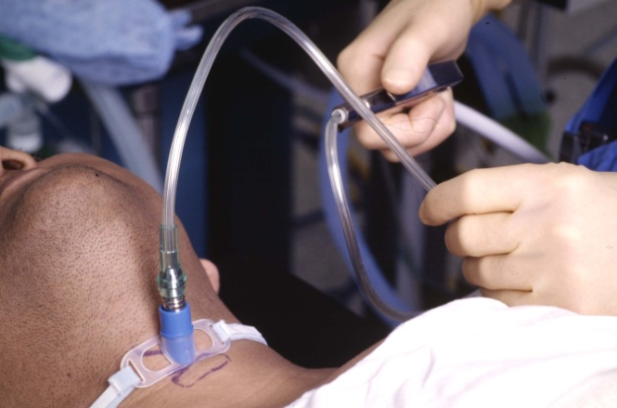
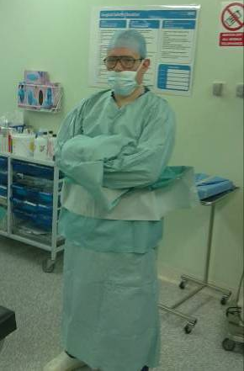
63% jet ventilation attempts failed
43% wide bore cannula crics failed
In anaesthesia & ED cases all surgical attempts successfully accessed the airway

Slide 13
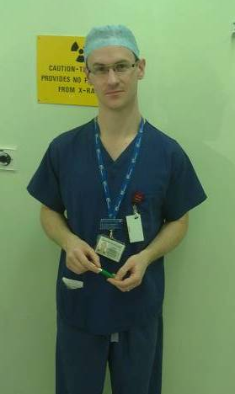
More often than not we defer to our surgical colleagues to rescue our patients airways

Slide 14
ICU (12 Cases) Emergency surgical airways were needed following:
Failed intubation
Failed Extubation (planned & unplanned)
Continuing deterioration while being observed in a place of safety

Slide 15
ICU (12 Cases) Lack of equipment was a particular problem:
Some units had no difficult airway trolley at all
Some were missing particular equipment that was required (proseal LMA, fibrescope)

Slide 16

Recommendations
Always discuss alternate options for plan A – especially AWAKE options
Openly discuss plans B, C & D
Use muscle relaxant and LMA early in CICV
Learn surgical cricothyroidotomy

